Slide 1
LABORATORY ASSIGNMENTS DATA STRUCTURES 2020
LUCAS JORGE ESPEJO 01674654R

Slide 2
INDEX
Analysis
Data Flow
Adaptations
Dynamic vs static implementation
Design
Box diagrams
UML
Behaviour
Implementation
Diagram source files
Difficult sections
Review
Enhancements

Slide 3

ANALYSIS

Slide 4
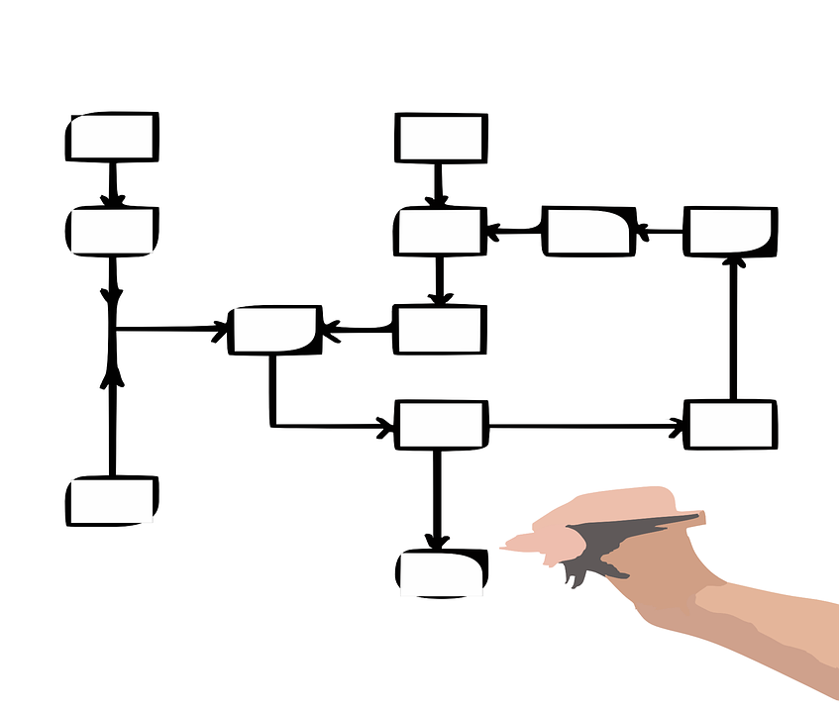
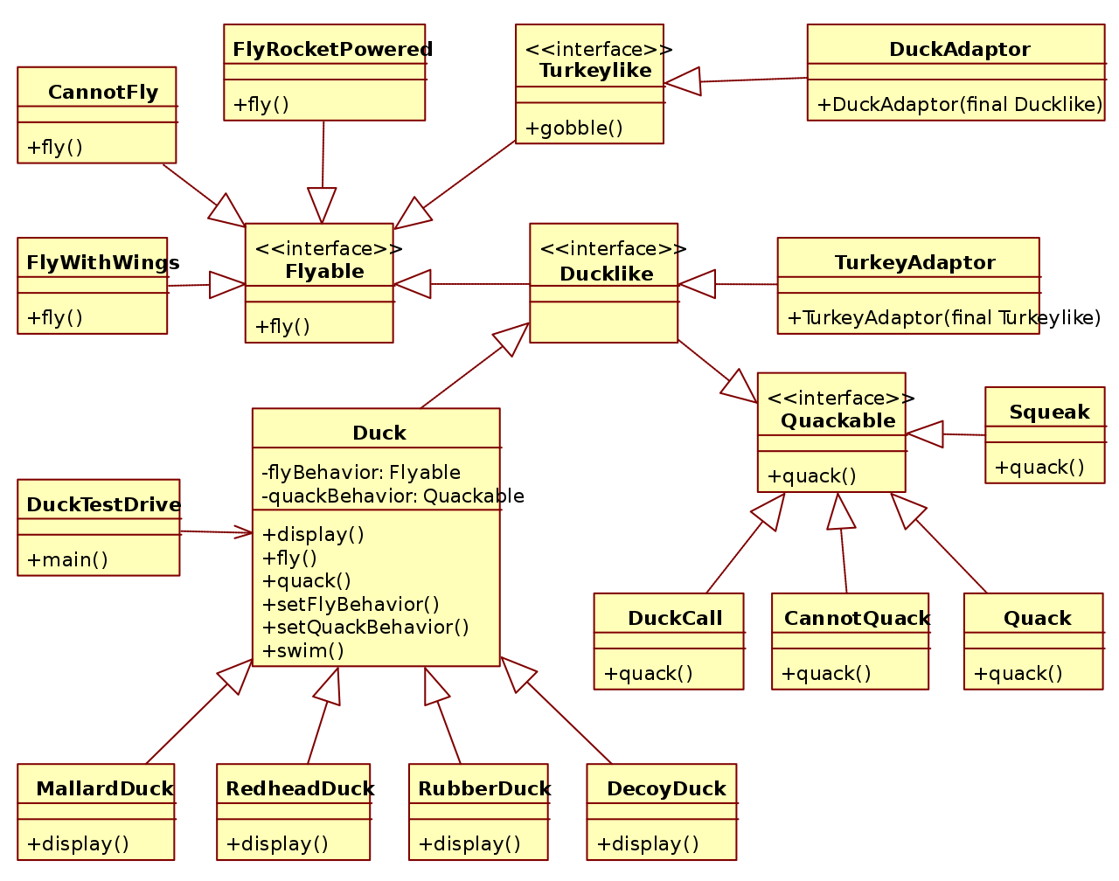

DESIGN
BOX DIAGRAMS
UML
BEHAVIOUR

Slide 5

IMPLEMENTATION

Slide 6

REVIEW
ENHANCEMENTS

